Slide 1
















Slide 2
“The first few weeks of Reception are about building relationships, developing confidence, learning routines and helping children feel that school is a safe, happy place where they belong.”
Settling in doesn’t look the same for every child and there is no ‘right’ way to settle!

Slide 3






Things we wish every Reception parent knew...
They will be tired! Reception is a BIG change and those little legs and brains are working hard all day.
We really do notice the little things - the first confident hello, the friend they finally played with, the time they tried something new. These moments matter to us too!
Tears at drop off don’t mean they’ve cried all day. They can be absolutely fine moments after you have left!
Your teacher is human too. We have lives, families, busy days and a million things happening beyond the classroom walls. We care deeply, but we can also make mistakes, forget things and get things wrong sometimes. A little kindness goes a long way. We are all on the same team and have the same goal.
Big emotions at home can be completely normal, especially in these first couple of months! They’ve spent all day trying their very best, following routines, managing friendships and holding it together. So home can be where it all comes out.
We hear LOTS about your home life!
We know your favourite takeaway, the books you read together and who had a late night!
We don’t expect them to be perfect. They're 4 and 5 year old's learning how to navigate friendships, emotions, routines and school.

Slide 4




What a typical day in Reception looks like...
  I hang up my things & I complete my morning activity (name writing practice)
  I answer the register, choose my lunch & find out what is going on today!
  I say my morning prayers
  I wake up my body & calm my mind with my morning sensory circuit
  I do a phonics lesson & learn new sounds
  I have time to learn through play with my friends during choose time
  I tidy up my classroom
  I sit on the carpet and I have an English lesson & rhyme time session
  I try to use the toilet & wash my hands ready for lunch
  I say my lunch time prayer then eat my lunch & play outside with my friends
  I settle myself back in class with some breathing exercises
  Some days we then have a topic lesson or it could be a music lesson or it could be an RE lesson!
  We then get more time to learn through play with our friends whilst our teacher asks us to complete some very important work
  We can also eat our snack in the afternoon!
  Then we tidy up again
  We then do a maths lesson with our teachers on the carpet
  Finally we say our prayers & get ready to go home & see our lovely families!
We promise you when they come home & say they did nothing - it’s not true!

Slide 5



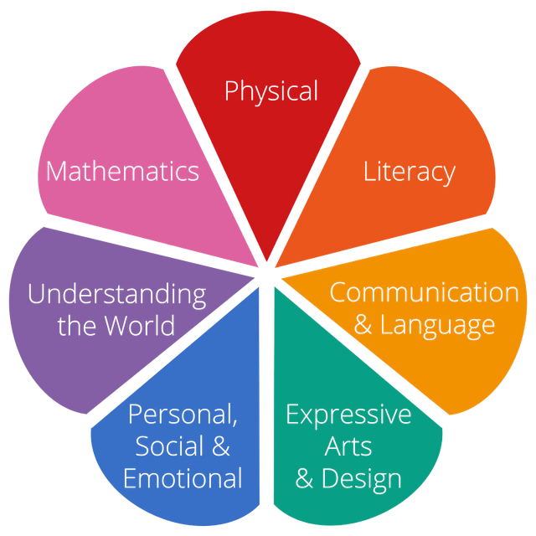
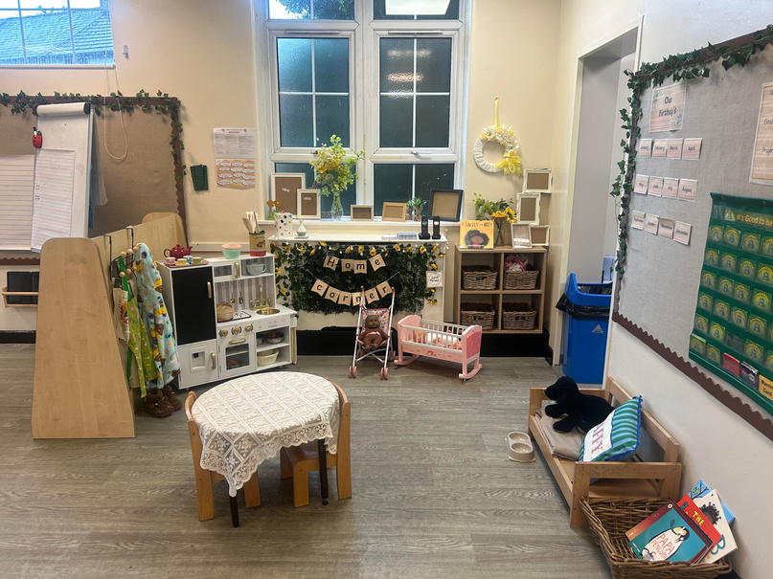
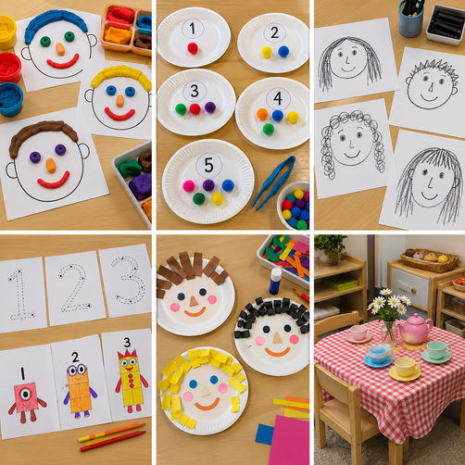

"Play is the work of the child." - Maria Montessori
We spend around half of the day taking part in play based learning.
The Unique Child - every child is an individual who is constantly learning and can be resilient, capable, confident, and self-assured

Slide 6



Tailored Learning: Adults adapt activities, teaching styles, and care to match the specific fascinations and needs of each child.
Observation: Practitioners closely watch and listen to children to understand their unique interests, strengths, and developmental stages
Continuous Assessment: Ongoing checks bridge typical child development patterns with what staff notice about the individual child, ensuring steady progress from their unique starting point.
Children learn through a combination of:
  adult-led teaching;
  small-group work;
  interactions with adults;
  play;
  exploration;
  continuous provision;
  outdoor learning.

Slide 7

Parent Partnership
You are your child’s first educator
You know your child better than anyone else
Your child is your priority & your most precious gift.
We hear you & we understand you!
We too are parents, we can sympathies with your anxieties, understand your concerns & we truly want to see your child happy, safe & thriving.
We are here to support you & we need your support to provide the best possible start for our children. The school journey is an adventure & Reception is the starting point.

Slide 8


Our Promise to you...
Positive, respectful and timely communication helps us build trust, prevent misunderstandings and secure the best outcomes for every child.
Keep parents informed about learning, progress and any emerging concerns
.Communicate calmly, professionally and respectfully.
Listen carefully and recognise that parents know their children well.
Address concerns early and avoid allowing issues to escalate.
Be clear about what school can do, what parents can do and the agreed next steps.
Record significant conversations and follow up agreed actions
Maintain confidentiality and never discuss children or families inappropriately.
Use agreed communication channels and involve a senior leader when needed.
We may not always agree, but we must always communicate respectfully and remain focused on the child.

Slide 9

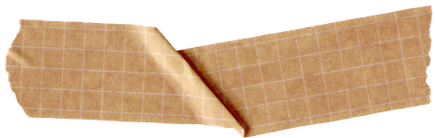

Communication is key!
You can use class dojo to send us a message - we will answer you as quickly as possible usually before or after school. (If we do not answer you during the school day it is because we are busy playing & ensuring your child is happy/safe)
We are available to take messages during drop off or pick up
(please be mindful that we have to make sure children are dismissed safely)
If you feel like you need time with your child’s class teacher or the EYFS lead please send us a message & we can arrange a time for you to come in, have a cuppa & speak to us face to face.

Slide 10


Please read any correspondence sent home (paper copies & dojo copies available) - this includes a weekly newsletter to stay up to date with what is going on in the classroom.
Communication is key!
At the end of each month we will update class dojo with an individual observation with an individual update on their progress and next steps
(starting October)
We will endeavor to update class dojo 2 times per week with group observations.

Slide 11


Expectations and Standards: The St Matthew’s Way
The St Matthew’s Way means providing consistently high standards for every child, in every classroom, every day.
•Children are welcomed warmly and known as individuals.
•Adults model calm, respectful and professional behaviour.
•Classrooms are organised, purposeful and ready for learning.
•Expectations for learning, behaviour and presentation are consistently high.
•Lessons are well planned, appropriately challenging and adapted to meet need.
•Reading, handwriting, number fluency and oracy remain visible priorities (this starts on day 1 of Reception)
•Staff actively teach, circulate, question and respond rather than remaining at a desk.
•Agreed routines, policies and individual support plans are followed consistently.
•Children’s dignity, safety and wellbeing are protected at all times.
•Concerns are addressed promptly and support is requested when needed.
•Consistency is not about every classroom looking identical. It is about every child receiving the same high standard of care, teaching and support.

Slide 12


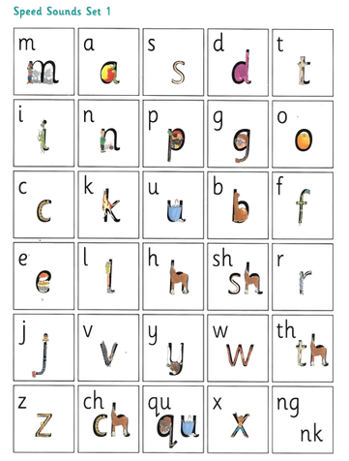



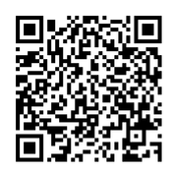
Our Partnership works both ways
We expect a lot from the children, parents expect a lot from the us & in return we expect your respect, participation & support.
Homework in Reception
Phonics
This week we have learnt the following sounds...
Find numbers – Look for the numbers 1, 2 and 3 around your home. Can you spot them on doors, clocks, books or signs?
Scan the QR code to watch the videos of Ellie & Fred with your child. Supporting your child with this will help develop their reading.
Look in a mirror – Talk about your hair, eye colour and other features. How are you similar to or different from other people in your family?
Practise your name – Have a go at writing your name, or make it using magnetic letters, pasta or other objects.
Each week children will bring home their newsletter with the sounds they have learnt during the week. Please spend time watching these videos with your child. After half term children will be grouped & the QR codes will be sent home half termly in the groups they are in.
Books Books Books!
Please read to your child every day and spend time talking about stories to develop a love of reading, support understanding and enhance oracy skills.
After half term (or when children are ready) they will start to bring home sound blending books to practice reading words at home.
Our weekly newsletter will also include some activities for you to complete with your child. You can send us photos on dojo of the children doing these or you can record this in your child’s homework book. Activities will become more structured as the year progresses.

Slide 13
Parent Partnership Events - Autumn 1
Tuesday 22nd - Fun Phonics Picnic
Join us to celebrate reading!
You will spend time exploring how your child learns to read in school, what you can do to support them at home then spend time reading stories with your child and their favourite teddy bear.
Apple Class 1:15-2:00
Cherry Class 2:15-3:00
Monday 19th or Tuesday 20th October - Stay & Play
This will be an end of topic stay & play session to celebrate everything your child has achieved in their first half term at St. Matthew’s. You will have a chance to see some activities that will support your child’s learning in action!
Invitations with your day & time will be sent out next week.

Slide 14

Attendance
We recognise the clear link between the attendance and achievement of pupils. Our aim is to encourage the highest possible levels of attendance and punctuality for pupils to support learning and development.
The importance of attendance and punctuality is underpinned by an awareness of safeguarding issues. It is important to see our children every day and provide an educationally safe and secure environment.
•
To gain the greatest benefit from their education it is vital that all pupils attend regularly and on time. Pupils should aim to attend every day that the school is open. We set a target for all pupils to aim for 100% attendance with the expectation all pupils achieve at least 97%.
As a school we define regular attendance as 97% or above. Children with attendance of 90% below are classed as persistently absent and are monitored closely
No Holidays are authorised

Slide 15


Uniform
Starting in Reception with a uniform gives the children a sense of belonging and equality amongst their peers.
I will insert pictures here – just need to get them off my Ipad.
Children in Reception don’t take part in ‘formal’ PE lessons but are expected to wear their uniform (which is our PE kit) daily. Children take part in a range of activities during the school day which supports their physical development (gross & fine motor skills). We will however be taking part in movement & story time sessions as the term progresses.

Slide 16


We use lots of rewards to promote positive behaviour.
For example:
•Good to be Green
•Friday phone calls
•Praise
•Show work to another teacher
•Certificates
•Class Dojo point- Dojo Shop
•Headteacher Award

Slide 17
Medical Information
•Mrs Evans/Mrs Chamberlain can offer advice on medical plans.
•Medicines can be administered in school, this must be organised at the school office.
•If a child has had First Aid in school you will receive notification. On occasions we may give a courtesy call home. We will also send home an intimate care slip home if your child has an accident & has been changed in school.
Food in School / Allergies Benedict's LAW
Benedict's Law is a set of statutory requirements which came into force in September 2026 that makes allergy safety a legal, whole-school responsibility across all schools in England
  No outside food can be brought in to Reception (this includes birthdays)
  Lunches & snacks are provided by school. We cater to a wide range of allergens.
  Snack will be served in the afternoons & supervised by a member of the team.

Slide 18
Autumn 1 Snack Menu
Monday | crackers & cheese
Tuesday | Yoghurt/fruit
Wednesday | humus & breadsticks
Thursday | wraps with ham & cheese
Friday | cereal & milk

Slide 19










Let's work together to make this an amazing year!

