Slide 1

Welcome to Year 1

Slide 2

Welcome to Key Stage One!
Now that the children have finished in Reception, they are now called Year 1 and they are part of Key Stage 1.
Key Stage 1 consists of both Year 1 and Year 2.
In Year 1 the classes are:
1 Oak
1 Birch

Slide 3
Staff
Teachers – Miss Gill and Ms Duffield
LSA – Mr Barlow (1 Oak) and Ms McGuire (1 Birch)
Headteacher – Mrs Sime
Deputy Headteachers – Mr Edwards and Mrs Evans
Family and Pastoral Support – Mrs Black
SENDCO - Mrs Roberts-Mosaid
Office Staff – Mrs Tippey and Miss Joshi

Slide 4

School Times
8:45 – Year 1 will enter school
8:45-8:55 – Registration
10:15-10:30 – Playtime
11:30-12:30– Lunch time
3:15 – Year 1 will leave via the classroom.

Slide 5

Attendance Matters
As a whole school, we expect 97% attendance- Every day counts!
Being in school every day means:
More learning opportunities 📚
Stronger friendships 🤝
Better progress and achievement 🌟
Registration closes at 8:55am so you must be in before that!

Slide 6
Attendance
We recognises the clear link between the attendance and achievement of pupils. Our aim is to encourage the highest possible levels of attendance and punctuality for pupils to support learning and development.
The importance of attendance and punctuality is underpinned by an awareness of safeguarding issues. It is important to see our children every day and provide an educationally safe and secure environment.
To gain the greatest benefit from their education it is vital that all pupils attend regularly and on time. Pupils should aim to attend every day that the school is open. We set a target for all pupils to aim for 100% attendance with the expectation all pupils achieve at least 97%.
As a school we define regular attendance as 97% or above. Children with attendance of 90% below are classed as persistently absent and are monitored closely
No Holidays are authorised

Slide 7
Medical
Mrs Evans/Mrs Chamberlain can offer advice on medical plans.
Medicines can be administered in school, this must be organised at the school office.
If a child has had First Aid in school you will receive notification. On occasions we may give a courtesy call home.
Please let the School Office know if there are any changes to your child’s medical requirements.

Slide 8



Food in School / Allergies Benedict's LAW
Benedict's Law is a set of mandatory school allergy safety requirements taking effect across England starting in September 2026
Lunch times – Please help us to promote healthy lunches.
You can refer to the website for further information.
Please note, we are a nut-free school.
No sweets or cakes in school for birthday treats

Slide 9

Food in School
Lunch times – Please help us to promote healthy lunches. You can refer to the website for further information. Please note, we are a nut-free school.
No sweets or cakes in school for birthday treats

Slide 10
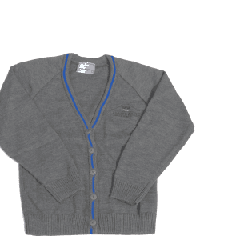



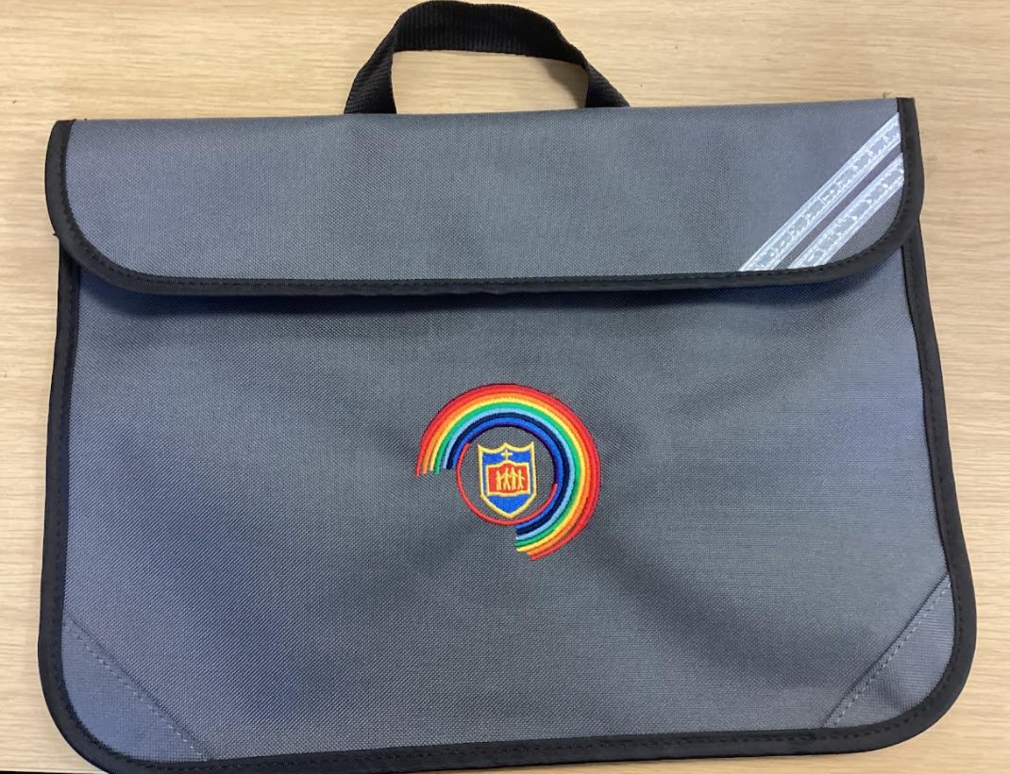
Uniform
Your child will need:
White shirt/blouse
Grey jumper/cardigan
Grey trousers or dress/skirt
School tie
Plain black shoes, not trainers

Slide 11


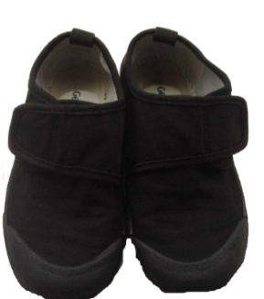
PE Kits and House Teams
Children will wear their P.E kits to school on the days that they have P.E.
We have P.E on a Tuesday and Thursday.
Your child will need;
House Group T-shirt
Blue shorts
Suitable pumps or trainers
School tracksuits are also available for colder months. Trainers only on PE days.

Slide 12
Expectations and Standards: The St Matthew’s Way
The St Matthew’s Way means providing consistently high standards for every child, in every classroom, every day.
Children are welcomed warmly and known as individuals.
Adults model calm, respectful and professional behaviour.
Classrooms are organised, purposeful and ready for learning.
Expectations for learning, behaviour and presentation are consistently high.
Lessons are well planned, appropriately challenging and adapted to meet need.
Reading, handwriting, number fluency and oracy remain visible priorities.
Staff actively teach, circulate, question and respond rather than remaining at a desk.
Agreed routines, policies and individual support plans are followed consistently.
Children’s dignity, safety and wellbeing are protected at all times.
Concerns are addressed promptly and support is requested when needed.
Consistency is not about every classroom looking identical. It is about every child receiving the same high standard of care, teaching and support.

Slide 13
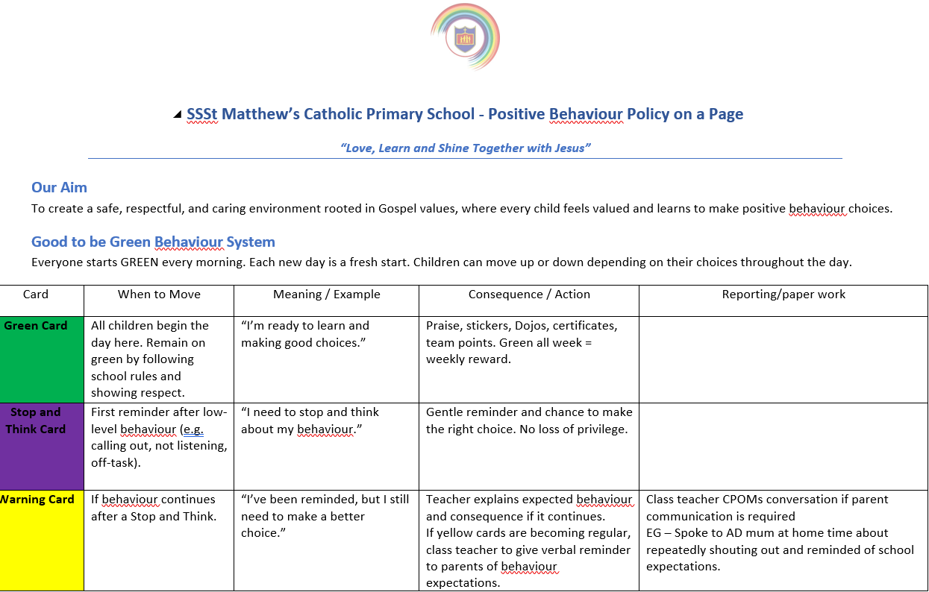

Home/School Agreement / Behaviour and relationship Policy
In the event of children not adhering to the code of conduct, behaviour and relationship the following sanctions will be applied using based on the seriousness of the behaviour.

Slide 14
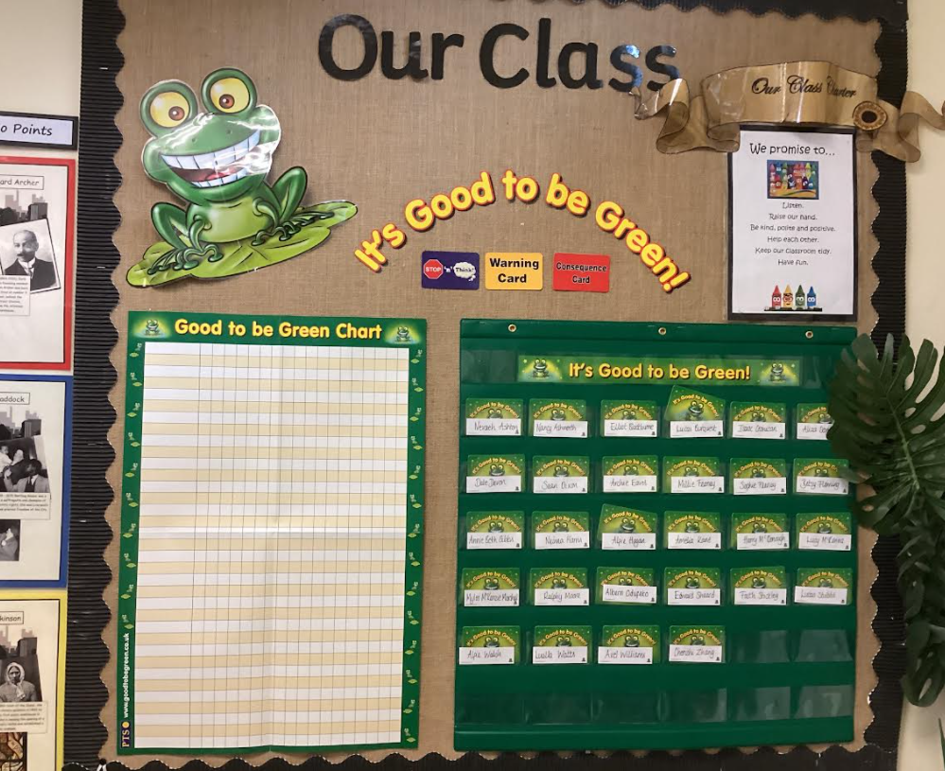
Good to be Green
Weekly Assembly Rewards!

Slide 15

Rewards
We use lots of rewards to promote positive behaviour.
For example:
Good to be Green
Friday phone calls
Stickers/stamps
Table of the week
Praise
Show work to another teacher
Certificates
Class Dojo point- Dojo Shop
Letter/ postcard home
Headteacher Award
Golden Star Chart
Celebration phone calls on a Friday

Slide 16
Attendance Matters
As a whole school, we expect 97% attendance- Every day counts!
Being in school every day means:
More learning opportunities 📚
Stronger friendships 🤝
Better progress and achievement 🌟
Registration closes at 8:55am so you must be in before that!

Slide 17
Homework
Our homework will consist of fun and engaging activity suggestions designed to support and reinforce what children are currently learning in school. These are optional ideas to help you enjoy learning together at home!
Homework will be uploaded to Dojo and Homework Books will be sent home on a Monday to be returned on a Thursday/Friday.
If you have any questions about Homework please speak to anyone in the Year 1 team.

Slide 18

Coming soon
New Mathematics – My Mathematics, Mathematics revision and practice for all, at the children's ability – assesses and adjusts as the children use it.

Slide 19
Phonics
Phonics is a key priority in Year 1, providing children with the essential skills needed to become confident and fluent readers and writers.
Children receive high-quality daily phonics teaching, with additional phonics practice and targeted support provided throughout the school day where needed.
Regular assessments are used to monitor progress, identify gaps in learning and ensure teaching is closely matched to individual needs. This focused approach supports children in developing the knowledge and confidence required for the statutory Year 1 Phonics Screening Check (May 2027), while ensuring that phonics skills are embedded and applied across the wider curriculum.

Slide 20
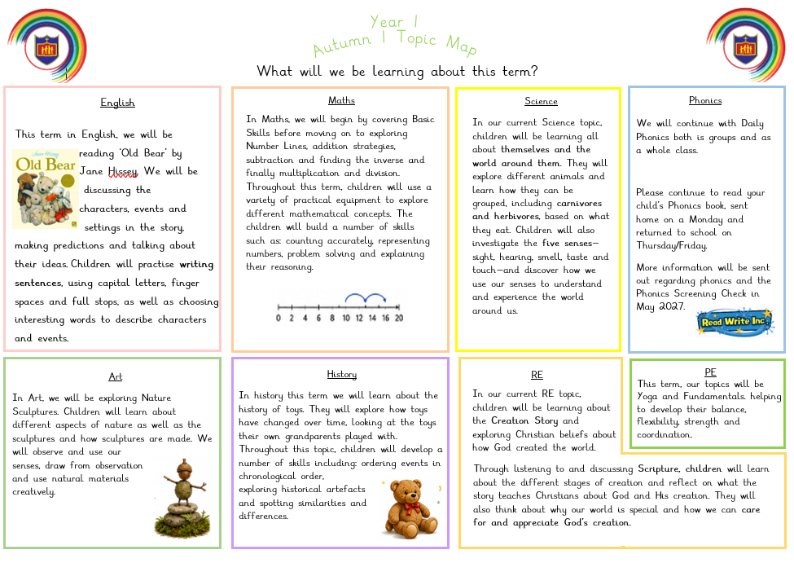
Topics we will cover

Slide 21
Working in Partnership with Parents – Our promise
Working in partnership with parents and carers is vital
Positive, respectful and timely communication helps us build trust, prevent misunderstandings and secure the best outcomes for every child.
Keep parents informed about learning, progress and any emerging concerns
.Communicate calmly, professionally and respectfully.
Listen carefully and recognise that parents know their children well.
Address concerns early and avoid allowing issues to escalate.
Be clear about what school can do, what parents can do and the agreed next steps.
Record significant conversations and follow up agreed actions
Maintain confidentiality and never discuss children or families inappropriately.
Use agreed communication channels and involve a senior leader when needed.
We may not always agree, but we must always communicate respectfully and remain focused on the child.

Slide 22
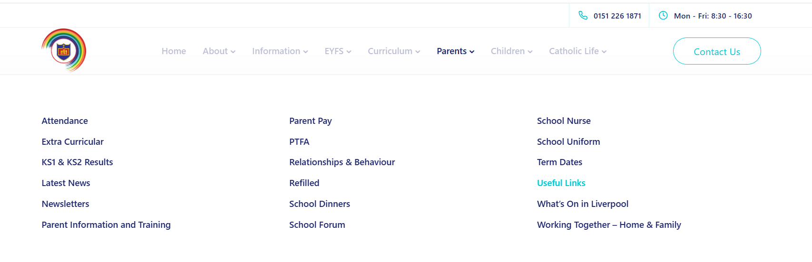
Further information can be found on our school website.

Slide 23
Information
Any further information can be found on our school website including: -
Policies
Uniform Details
Contact Information
Curriculum Information

Slide 24
Please don’t hesitate to contact us with any issues, we would be more than happy to have a chat.

