Slide 1

Year 2

Slide 2

Staff
Teacher – Ms McWilliams (2 Fir) and Miss Tidmore (2 Alder)
Head teacher – Mrs. Sime
Deputy Heads –Mr Edwards and Mrs Evans
Inclusion Manager/ SENCO- Mrs Mosaid
Office Staff - Mrs Tippey and Miss Joshi

Slide 3

School Times
8:40 Gates open
8:50-8:55 Register taken
10:15-10:30 Breaktime
11:30-12:30 Lunchtime
3:05 Gates open
3:15 Hometime

Slide 4

Attendance
We recognises the clear link between the attendance and achievement of pupils. Our aim is to encourage the highest possible levels of attendance and punctuality for pupils to support learning and development.
The importance of attendance and punctuality is underpinned by an awareness of safeguarding issues. It is important to see our children every day and provide an educationally safe and secure environment.
To gain the greatest benefit from their education it is vital that all pupils attend regularly and on time. Pupils should aim to attend every day that the school is open. We set a target for all pupils to aim for 100% attendance with the expectation all pupils achieve at least 97%.
As a school we define regular attendance as 97% or above

Slide 5

A message for our children…

Slide 6
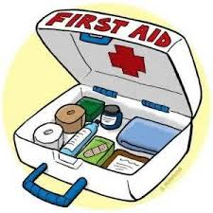
Medical
Mrs Evans/Mrs Chamberlain can offer advice on medical plans.
Medicines can be administered in school, this must be organised at the school office.
If a child has had First Aid in school you will receive notification. On occasions we may give a curtsey call home.

Slide 7


Food in School.
Snack times - Children are provided with a piece of fruit everyday
Lunch times – Please help us to promote healthy lunches. You can refer to the website for further information. Please note, we are a nut-free school. Packed lunches are only allowed in Key stage 2.

Slide 8
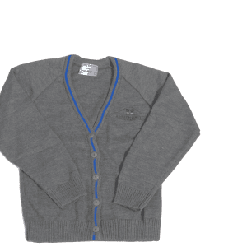

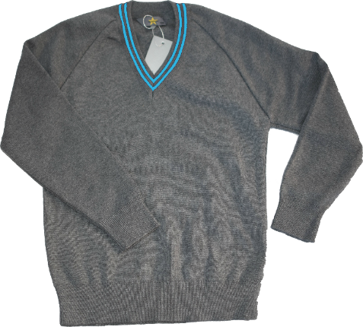

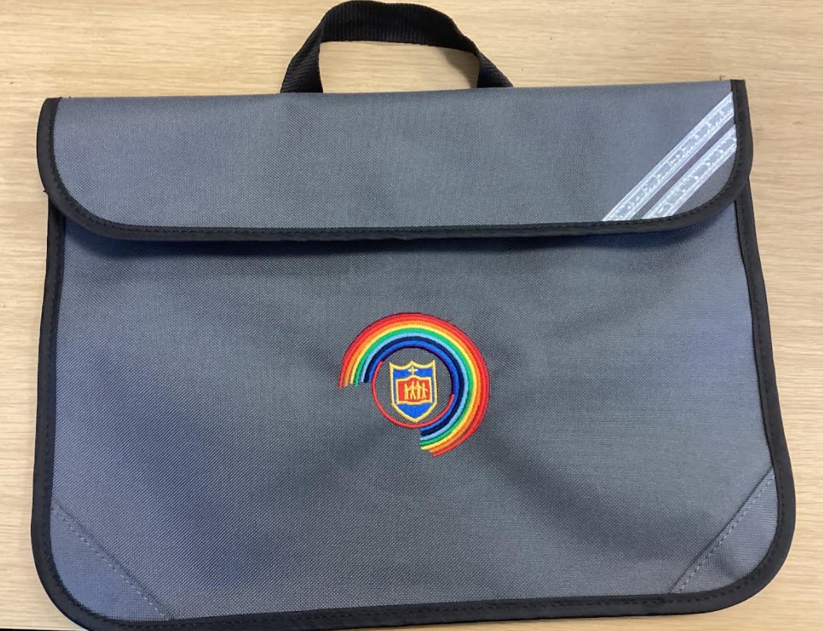
Uniform
Your child will need:
White shirt/blouse
Grey jumper/cardigan
Grey trousers or dress/skirt
School tie
Plain black shoes.

Slide 9

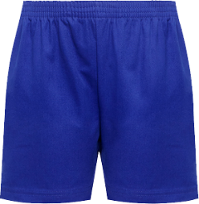
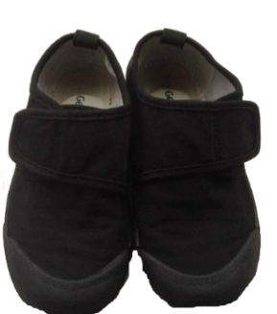
PE Kits
Children will wear their P.E kits to school on the days that they have P.E!
We have P.E on a Thursday and Friday.
Your child will need;
House Group T-shirt
Blue shorts
Suitable pumps or trainers
School tracksuits are also available for colder months

Slide 10

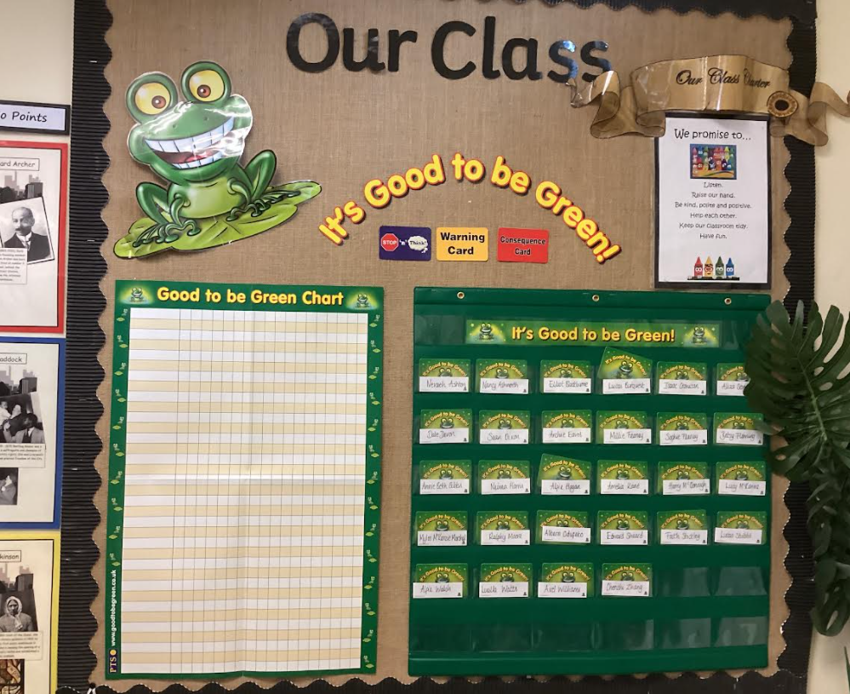



Good to be Green…
Weekly Assembly Rewards!

Slide 11

Rewards
We use lots of rewards to promote positive behaviour!
For example:
Good to be Green
Stickers/stamps
Table of the week
Praise
Show work to another teacher
Certificates
Class Dojo point- Dojo Shop
Friday Phone Call
Headteacher Award
Golden Star Chart

Slide 12

Home/School Agreement.
In the event of children not adhering to the code of conduct, the following sanctions will be applied using adult discretion based on the seriousness of the behaviour.

Slide 13

Phonics…
https://home.oxfordowl.co.uk/reading/reading-schemes-oxford-levels/read-write-inc-phonics-guide/

Slide 14

Reading Books
Reading books are given out by your child’s phonics teacher on their allocated days. Your child will know when this is.
Children should try to read every night!

Slide 15

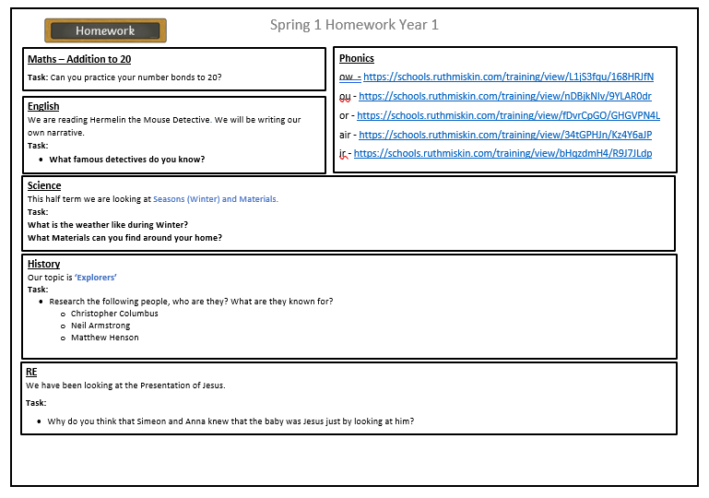
Our homework will consist of fun and engaging activity suggestions designed to support and reinforce what children are currently learning in school. These are ideas to help you enjoy learning together at home! This will be sent out on Dojo every Monday.

Slide 16



Apps to use at home…
Codes will be sent home.

Slide 17
Topics this year…
Art
Portraits
Sculpture- Antony Gormley
Textiles and Collage
DT
Sewing Christmas Stockings
Mechanisms
Geography
Maps
Australia
The Seaside
Science
Living Things
Animals including humans
Everyday Materials
Scientists and their inventions
Plants
History
The Great Fire of London
Nursing
Kitty Wilkinson

Slide 18



Homework
Homework is sent out on Class Dojo, TT Rockstars, Mymaths and Reading plus. More details will follow.

Slide 19
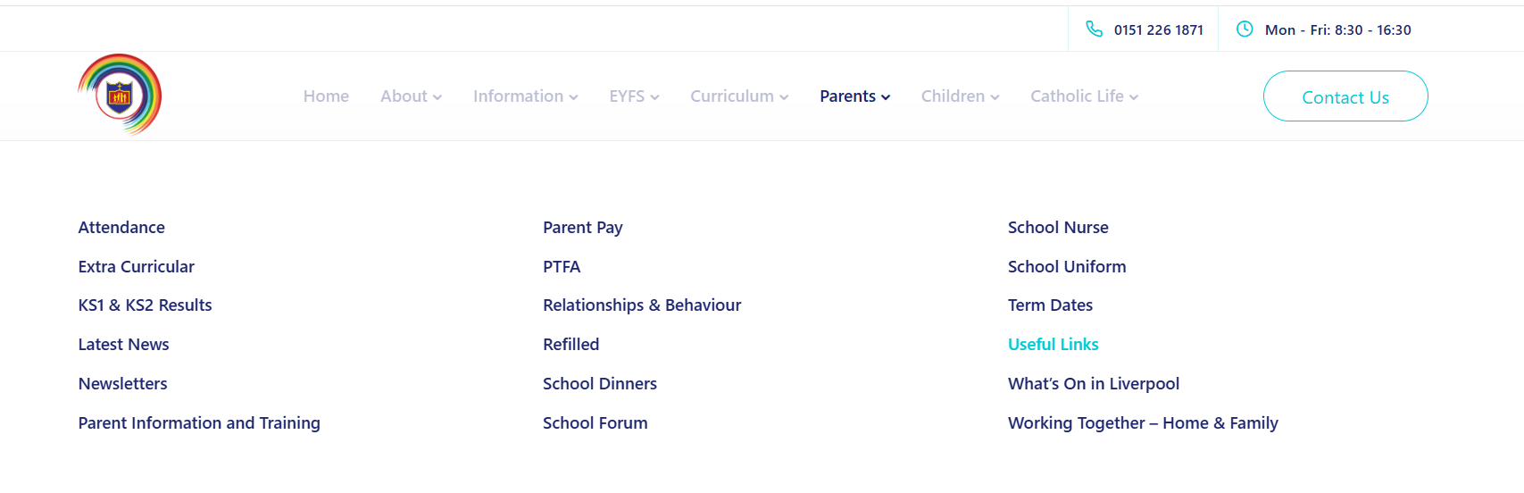
Further information can be found on our school website.

Slide 20

Please don’t hesitate to contact us with any issues, we would be more than happy to have a chat.

