Slide 1




Welcome to Year 3!
Class Teachers: 3 Elm Miss Milner
3 Cedar Miss Patterson
LSA: 3 Elm Mrs Coleman
3 Cedar Mr Mitchell

Slide 2
Staff
Teachers – Miss Milner and Miss Patterson
LSA’s – Mrs Coleman and Mr Mitchell
Headteacher – Mrs Sime
Assistant & Deputy Headteachers – Mrs Evans and Mr Edwards
Inclusion Manager - Mrs Roberts Mosaid
School Business Manager – Mrs Chamberlain
Family and Pupil Support – Mrs Black
Office Staff – Mrs Tippey & Miss Roshi

Slide 3
School day
8:40 – Children will enter school
8:45-8:50- Registration
10:30 - Play time
11:45 – Lunch time
3:15 – Year 3 are collected from their allocated line on the yard

Slide 4

Attendance Matters!
Every Day, On Time: We strive for 100% attendance and love telling the children: "It’s cool to be in school!“
We recognises the clear link between the attendance and achievement of pupils. Our aim is to encourage the highest possible levels of attendance and punctuality for pupils to support learning and development.
The importance of attendance and punctuality is underpinned by an awareness of safeguarding issues. It is important to see our children every day and provide an educationally safe and secure environment.
To gain the greatest benefit from their education it is vital that all pupils attend regularly and on time. Pupils should aim to attend every day that the school is open. We set a target for all pupils to aim for 100% attendance with the expectation all pupils achieve at least 97%.
As a school we define regular attendance as 97% or above. Children with attendance of 90% below are classed as persistently absent and are monitored closely

Slide 5
No Holidays are authorised
Reporting Illness: If your child is unwell, please inform the school office as soon as possible
Coughs & Colds: Minor ailments shouldn't keep children home! With your permission, we can administer medicine at school to keep them comfortable and learning.

Slide 6

Medical
Mrs Evans/Mrs Chamberlain can offer advice
on medical plans.
Medicines can be administered in school, this
must be organised at the school office.
If a child has had First Aid in school you will
receive notification. On occasions we may give a
curtsey call home.

Slide 7
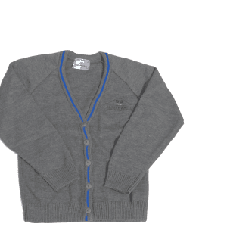

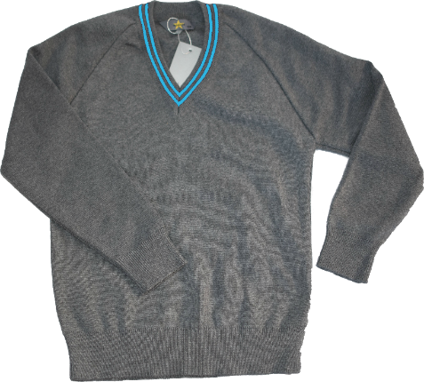
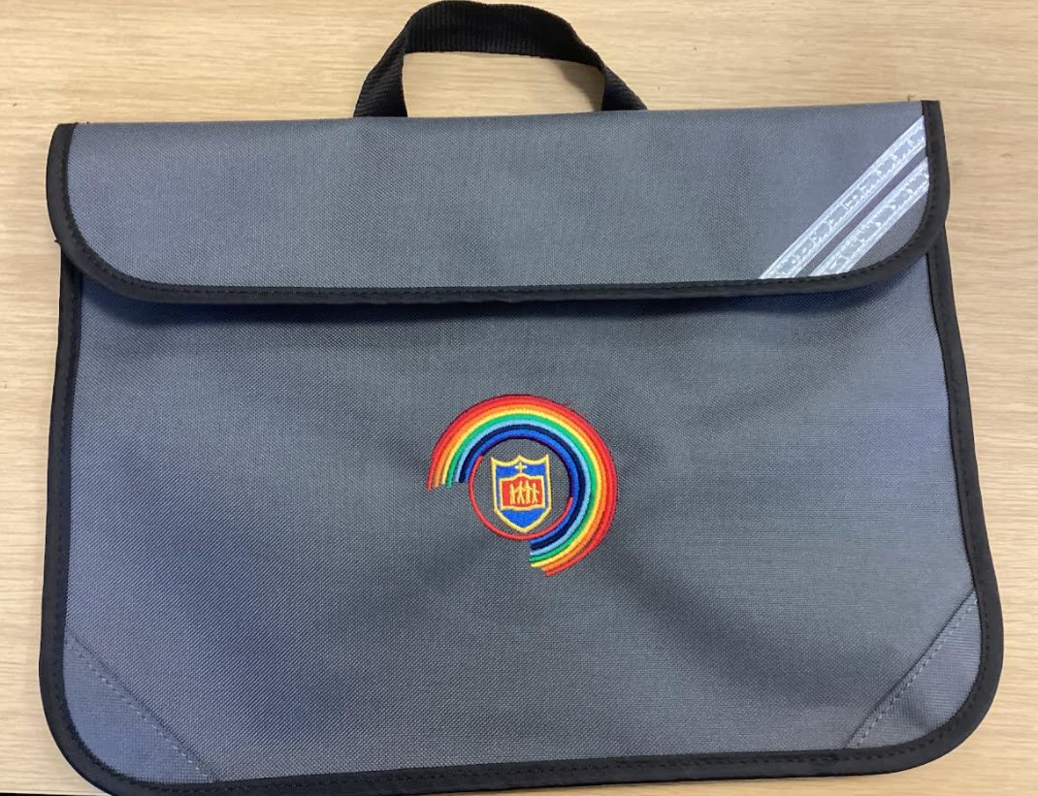

Uniform
Your child will need to wear:
White shirt/blouse
Grey jumper/cardigan
Grey trousers /dress or skirt
School tie
Plain black school shoes / no trainers

Slide 8
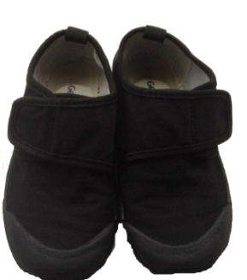


PE Kits
PE Day – Monday & Wednesday
Children wear their PE kits to school on the days they have PE!
Both classes have the same PE days:
Your child will need:
- House colour shirt
- Blue shorts
- Suitable pumps or trainers
- School tracksuits are also available for the Winter months.

Slide 9
Expectations and Standards: The St Matthew’s Way
The St Matthew’s Way means providing consistently high standards for every child, in every classroom, every day.
Children are welcomed warmly and known as individuals.
Adults model calm, respectful and professional behaviour.
Classrooms are organised, purposeful and ready for learning.
Expectations for learning, behaviour and presentation are consistently high.
Lessons are well planned, appropriately challenging and adapted to meet need.
Reading, handwriting, number fluency and oracy remain visible priorities.
Staff actively teach, circulate, question and respond rather than remaining at a desk.
Agreed routines, policies and individual support plans are followed consistently.
Children’s dignity, safety and wellbeing are protected at all times.
Concerns are addressed promptly and support is requested when needed.
Consistency is not about every classroom looking identical. It is about every child receiving the same high standard of care, teaching and support.

Slide 10

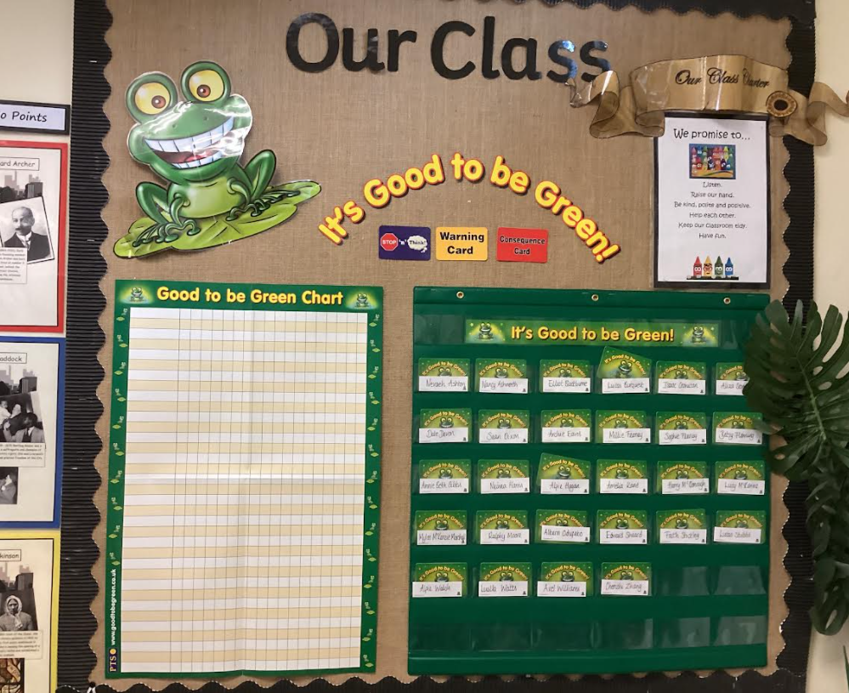



Good to be Green….
Weekly Assembly Rewards!

Slide 11
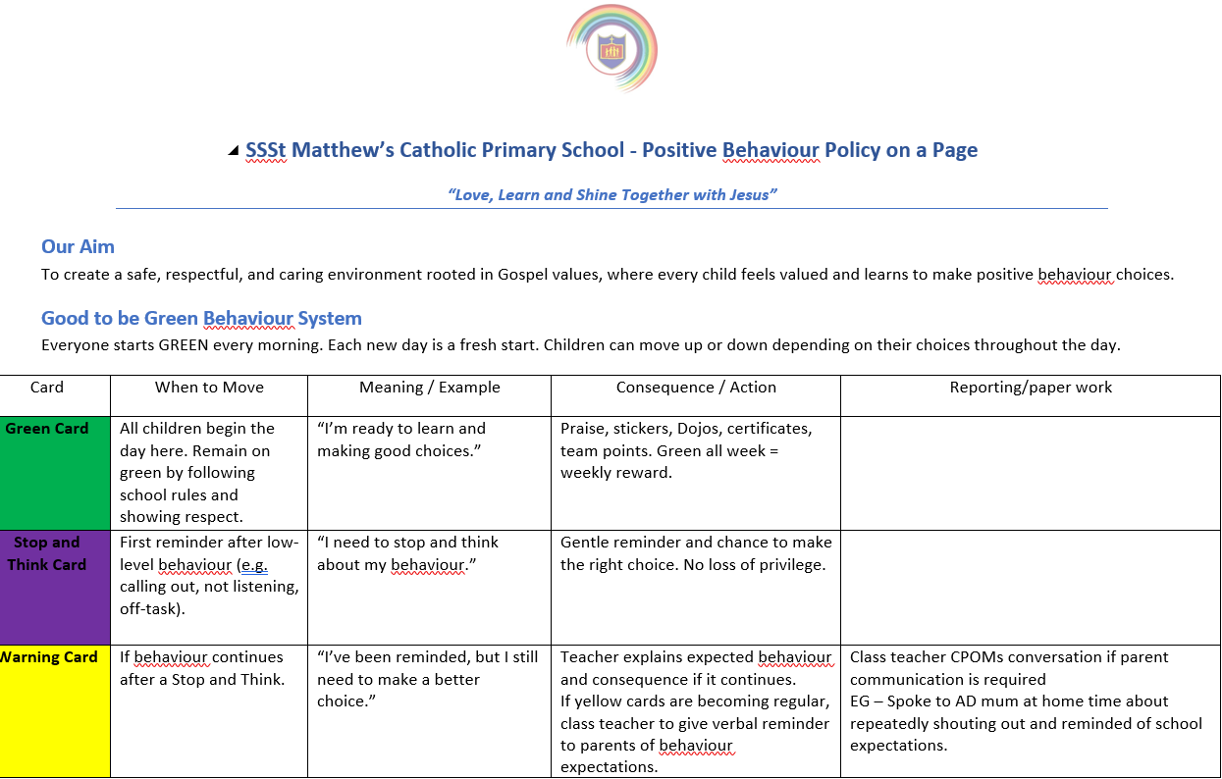

Home/School Agreement / Behaviour and relationship Policy
In the event of children not adhering to the code of conduct, behaviour and relationship the following sanctions will be applied using based on the seriousness of the behaviour.

Slide 12
Curriculum Overview
Science – Rocks and soils
Animals including humans
Plants
Light
History – Changes in Britain from Stone Age to Iron Age.
The Roman Empire and its impact on Britain
Marvellous Mersey
Geography - Countries and Cities
Mountains/Everest
  Spain and Catalonia
Literacy – Stories with familiar settings
Poetry
Myths
Reports
Creative writing
English
Maths
Science
RE
Spelling
Spanish
Foundation subjects
PE (Swimming in Summer term)

Slide 13

We use lots of rewards to promote positive behaviour!
For example:
Stickers
Good to be Green
Star of the week
Dojo winners
Praise
Reward jar
Letter/postcard home
Showing work to other teachers
School team points and awards

Slide 14
Reading
Children should try to read every night!
- Reading sources can be a wide range of literature including magazines, internet, news articles, comics, novels and poetry.
- Use your reading plus login, even short bursts of reading help!

Slide 15
Reading Books
Reading books are given out by your child’s phonics teacher on their allocated days. Your child will know when this is.
If your child does not attend phonics sessions then the class teacher will send a book home on a Monday it should be brought into school on a Thursday, checked and signed by an adult

Slide 16

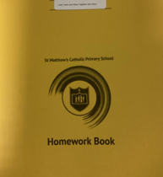
Our homework will consist of fun and engaging activity suggestions designed to support and reinforce what children are currently learning in school. These are optional ideas to help you enjoy learning together at home!
Homework and reading books are given out every Monday and to be returned to school on a Thursday.

Slide 17
Marking
One strength of their work will be underlined in green so children can recognise what was a key part of their work that stood out
Children can earn ⭐ Golden Stars for:
✨ Brilliant effort – you have tried your very best.
✍️ Beautiful handwriting – your letters are neat and carefully formed.
📚 Key vocabulary – you have used fantastic words from our learning.
🎨 Beautiful presentation – your work is neat, tidy and carefully presented.
🌟 Going above and beyond – you have challenged yourself and produced something amazing!
🏆 Collect 20 Golden Stars!
20 Golden Stars = 🎓 A Golden Star Certificate + 🎁 A visit to the Prize Box!

Slide 18
Positive Phone call home on a Friday
Every Friday, children will have the opportunity to be chosen for a Fantastic Friday phone call! 🌟
If you have had a fabulous week in school, your teacher may call home to tell parents/carers all about some amazing achievements.
You might be chosen because you have:
⭐ Shown brilliant effort
📚 Made great progress
💛 Been kind, caring and helpful
✍️ Produced beautiful work
🙋‍♀️ Shown excellent learning behaviours
🌟 Gone above and beyond

Slide 19



Apps to use at home…

Slide 20

Coming soon
New Mathematics – My Mathematics, Mathematics revision and practice for all, at the children's ability – assesses and adjusts as the children use it.

Slide 21
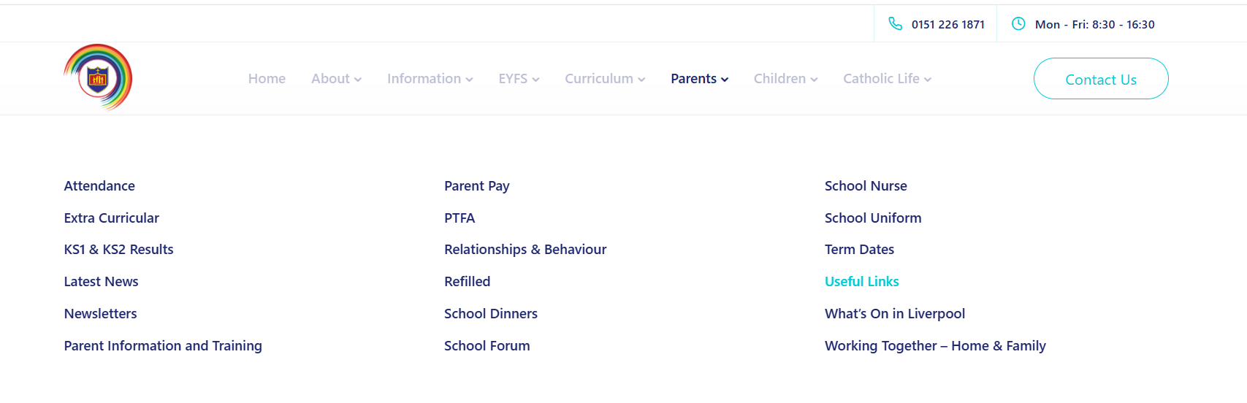
Further information can be found on our school website

Slide 22
Working in Partnership with Parents – Our promise
Working in partnership with parents and carers is vital
Positive, respectful and timely communication helps us build trust, prevent misunderstandings and secure the best outcomes for every child.
Keep parents informed about learning, progress and any emerging concerns
.Communicate calmly, professionally and respectfully.
Listen carefully and recognise that parents know their children well.
Address concerns early and avoid allowing issues to escalate.
Be clear about what school can do, what parents can do and the agreed next steps.
Record significant conversations and follow up agreed actions
Maintain confidentiality and never discuss children or families inappropriately.
Use agreed communication channels and involve a senior leader when needed.
We may not always agree, but we must always communicate respectfully and remain focused on the child.

Slide 23


Please do not hesitate to contact myself if you have any questions!

