Slide 1

Year 4

Slide 2

Welcome to Year 4
Year 4 is a fantastic year. It involves an exciting trip, First Holy Communion and lots of hard work on times tables which will be assessed during the times tables screening check.

Slide 3

Staff
Teachers – 4 Maple – Miss Watts
4 Ash – Miss. Connor
LSAs– Mr Collins and Miss Rogerson
Head teacher – Mrs. Sime
Deputy Heads –Mr Edwards and Mrs Evans
Inclusion Manager - Mrs Mosaid
Office Staff - Mrs Tippey, Miss Joshi

Slide 4

School Times
8:40 – Year 4 will enter school
8:40-8:55 – Registration
10. 30 – 10.45 – Playtime
11.45–12:45 Lunch time
Home time – 3.15pm

Slide 5

Attendance
We recognises the clear link between the attendance and achievement of pupils. Our aim is to encourage the highest possible levels of attendance and punctuality for pupils to support learning and development.
The importance of attendance and punctuality is underpinned by an awareness of safeguarding issues. It is important to see our children every day and provide an educationally safe and secure environment.
To gain the greatest benefit from their education it is vital that all pupils attend regularly and on time. Pupils should aim to attend every day that the school is open. We set a target for all pupils to aim for 100% attendance with the expectation all pupils achieve at least 97%.
As a school we define regular attendance as 97% or above. Children with attendance of 90% below are classed as persistently absent and are monitored closely
No Holidays are authorised

Slide 6

A message for our children…

Slide 7

Medical
Mrs Evans/Mrs Chamberlain can offer advice on medical plans.
Medicines can be administered in school, this must be organised at the school office.
If a child has had First Aid in school you will receive notification. On occasions we may give a courtesy call home.

Slide 8


Food in School / Allergies Benedict's LAW
Lunch times – Please help us to promote healthy lunches. You can refer to the website for further information. Please note, we are a nut-free school.
No sweets or cakes in school for birthday treats

Slide 9
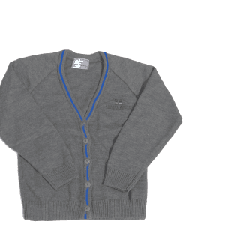

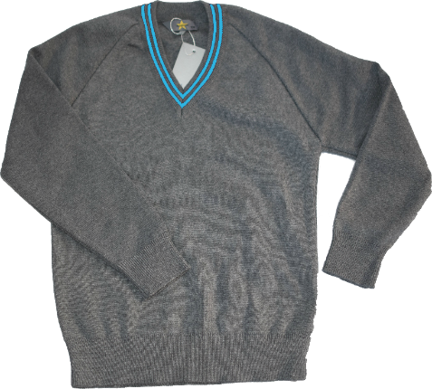

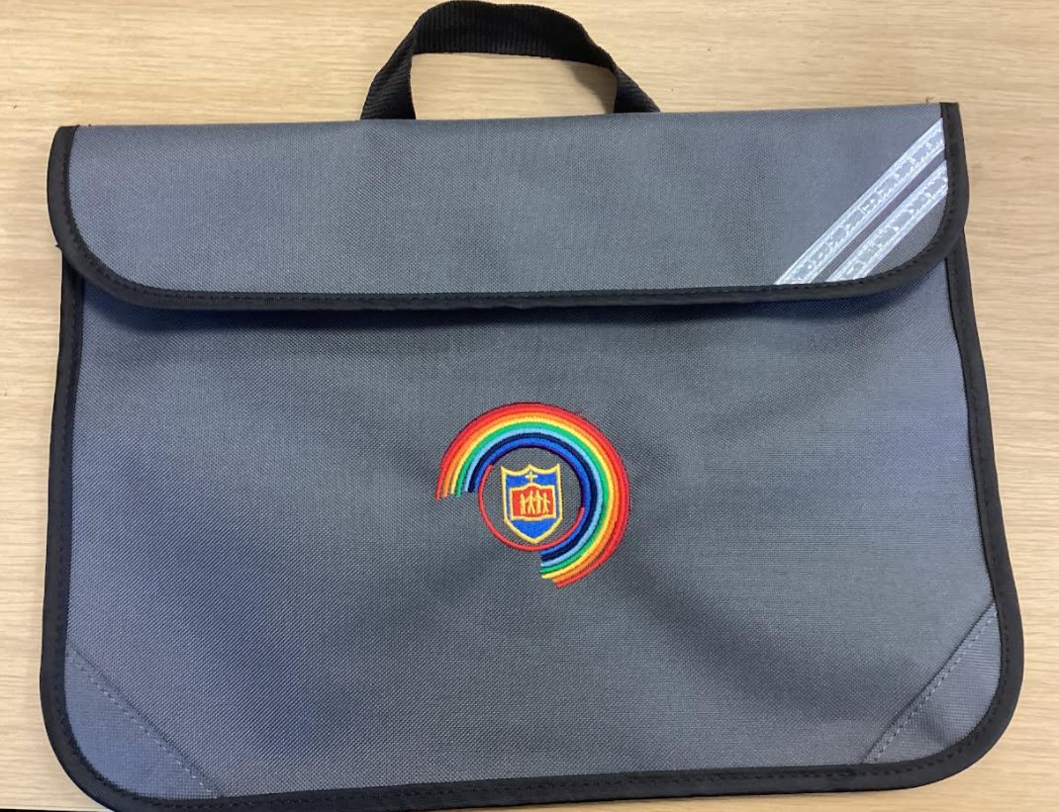
Uniform
Your child will need:
White shirt/blouse
Grey jumper/cardigan
Grey trousers or dress/skirt
School tie
Plain black shoes, not trainers
Please note: it is not a reasonable
adjustment to not wear uniform, difficulties speak to staff

Slide 10


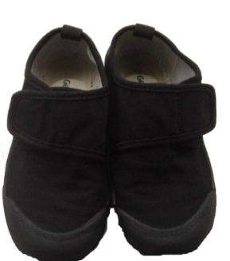
PE Kits
Children will wear their P.E kits to school on the days that they have P.E.
We have P.E on a Thursday and for the next 10 weeks we will go swimming of a Wednesday for 4 Ash and Friday for 4 Maple.
Your child will need;
House Group T-shirt
Blue shorts
Suitable pumps or trainers
School tracksuits are also available for colder months. Trainers only on PE days.

Slide 11
Expectations and Standards: The St Matthew’s Way
The St Matthew’s Way means providing consistently high standards for every child, in every classroom, every day.
Children are welcomed warmly and known as individuals.
Adults model calm, respectful and professional behaviour.
Classrooms are organised, purposeful and ready for learning.
Expectations for learning, behaviour and presentation are consistently high.
Lessons are well planned, appropriately challenging and adapted to meet need.
Reading, handwriting, number fluency and oracy remain visible priorities.
Staff actively teach, circulate, question and respond rather than remaining at a desk.
Agreed routines, policies and individual support plans are followed consistently.
Children’s dignity, safety and wellbeing are protected at all times.
Concerns are addressed promptly and support is requested when needed.
Consistency is not about every classroom looking identical. It is about every child receiving the same high standard of care, teaching and support.

Slide 12

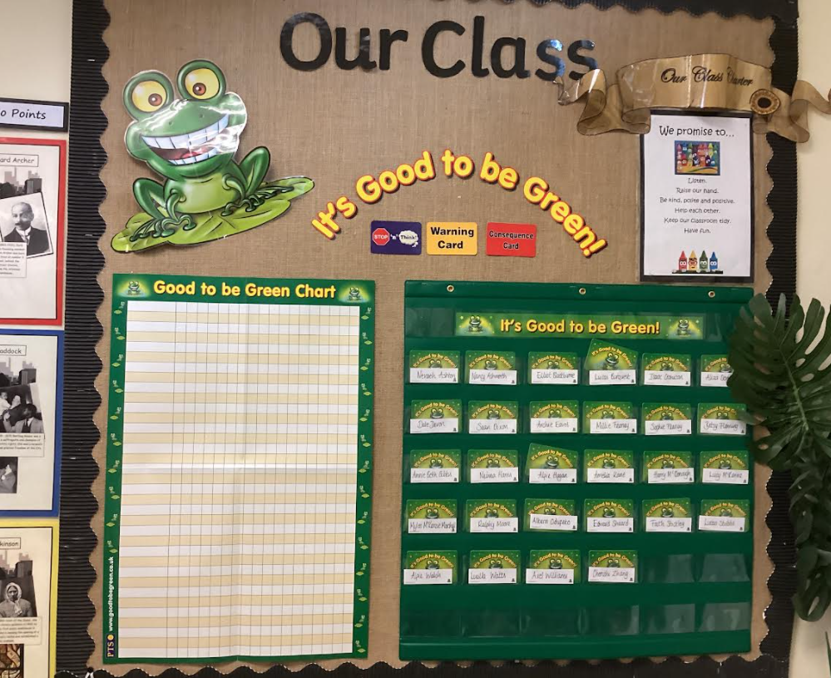



Good to be Green….
Weekly Assembly Rewards!

Slide 13

Rewards
We use lots of rewards to promote positive behaviour.
For example:
Good to be Green
Friday phone calls
Stickers/stamps
Table of the week
Praise
Show work to another teacher
Certificates
Class Dojo point- Dojo Shop
Letter/ postcard home
Headteacher Award
Golden Star Chart

Slide 14
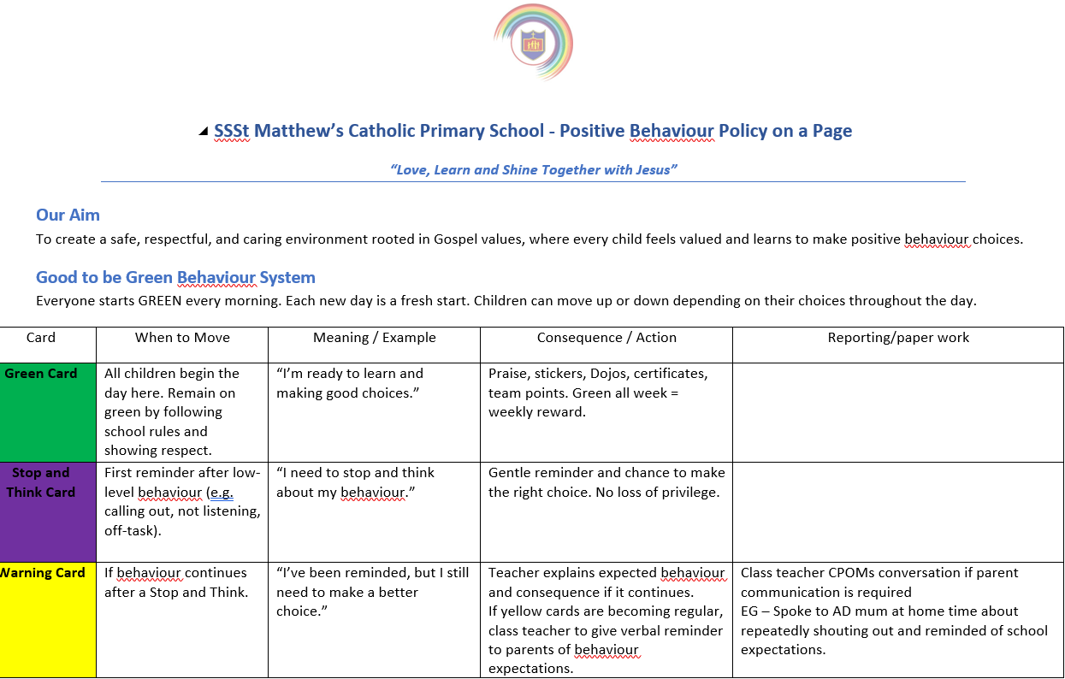

Home/School Agreement / Behaviour and relationship Policy
In the event of children not adhering to the code of conduct, behaviour and relationship the following sanctions will be applied using based on the seriousness of the behaviour.

Slide 15

Reading Books
Reading books are given out by your child’s teacher on their allocated days - Monday. Your child will know when this is.
Children should try to read every night.

Slide 16

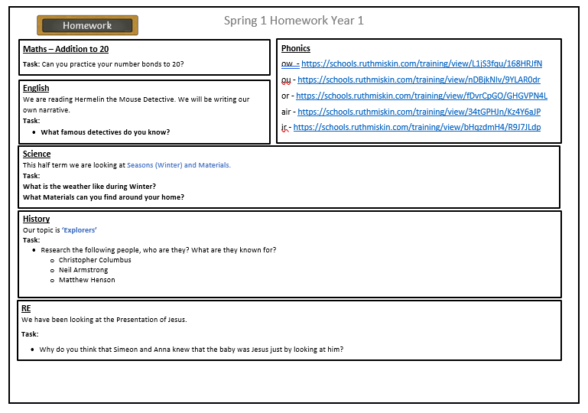
Our homework will consist of fun and engaging activity suggestions designed to support and reinforce what children are currently learning in school. These are optional ideas to help you enjoy learning together at home!

Slide 17


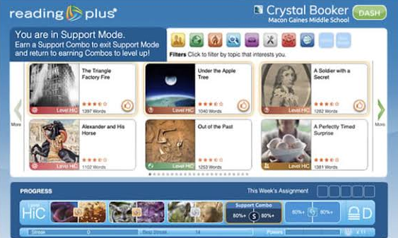
Apps to use at home…
Codes will be sent home

Slide 18

Coming soon
New Mathematics – My Mathematics, Mathematics revision and practice for all, at the children's ability – assesses and adjusts as the children use it.

Slide 19
Multiplication Check for Year 4 Children
The Department for Education has scheduled the 2027 Year 4 Multiplication Check from Monday 7th June to Friday 18th June 2027.
We will ensure children are prepared but not stressed – we will endeavour to not apply pressure or make children feel anxious about tests.

Slide 20



Homework
Homework is sent out on Class Dojo, TT Rockstars, My maths and Reading plus. More details will follow

Slide 21
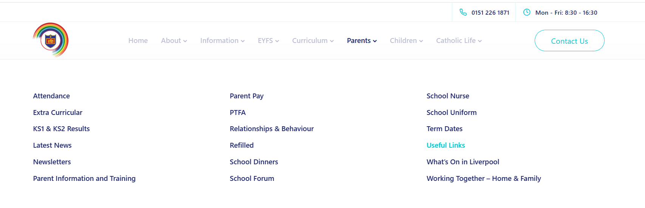
Further information can be found on our school website

Slide 22
Working in Partnership with Parents – Our promise
Working in partnership with parents and carers is vital
Positive, respectful and timely communication helps us build trust, prevent misunderstandings and secure the best outcomes for every child.
Keep parents informed about learning, progress and any emerging concerns
.Communicate calmly, professionally and respectfully.
Listen carefully and recognise that parents know their children well.
Address concerns early and avoid allowing issues to escalate.
Be clear about what school can do, what parents can do and the agreed next steps.
Record significant conversations and follow up agreed actions
Maintain confidentiality and never discuss children or families inappropriately.
Use agreed communication channels and involve a senior leader when needed.
We may not always agree, but we must always communicate respectfully and remain focused on the child.

Slide 23

Please don’t hesitate to contact us with any issues, we would be more than happy to have a chat.

