Slide 1


WELCOME TO YEAR 5!

Slide 2


Slide 3
Staff
Teachers – Mrs Dunbar, Mr Wall,
Support staff – Mrs Hart and Miss McCafferty
Head teacher – Mrs. Sime
Deputy Heads –Mr Edwards and Mrs Evans
KS2 lead- Mrs Dunbar
Inclusion Manager - Mrs Mosaid
Office Staff - Mrs Tippey, Miss Joshi

Slide 4
School Times
7:45am – Breakfast Club Opens
8.40am – Morning Gates Open
8:55am – Registration and basic skills
10:45-11:00am – Upper Key Stage 2 Breaktime
12:00- 13:00pm – Upper Key Stage 2 Lunchtime
3:15pm – Home Time

Slide 5
Attendance Matters
As a whole school, we expect 97% attendance- Every day counts!
Being in school every day means:
More learning opportunities 📚
Stronger friendships 🤝
Better progress and achievement 🌟
Registration closes at 8:55am so you must be in before that!

Slide 6
We recognises the clear link between the attendance and achievement of pupils. Our aim is to encourage the highest possible levels of attendance and punctuality for pupils to support learning and development.
The importance of attendance and punctuality is underpinned by an awareness of safeguarding issues. It is important to see our children every day and provide an educationally safe and secure environment.
To gain the greatest benefit from their education it is vital that all pupils attend regularly and on time. Pupils should aim to attend every day that the school is open. We set a target for all pupils to aim for 100% attendance with the expectation all pupils achieve at least 97%.
As a school we define regular attendance as 97% or above. Children with attendance of 90% below are classed as persistently absent and are monitored closely
No Holidays are authorised

Slide 7

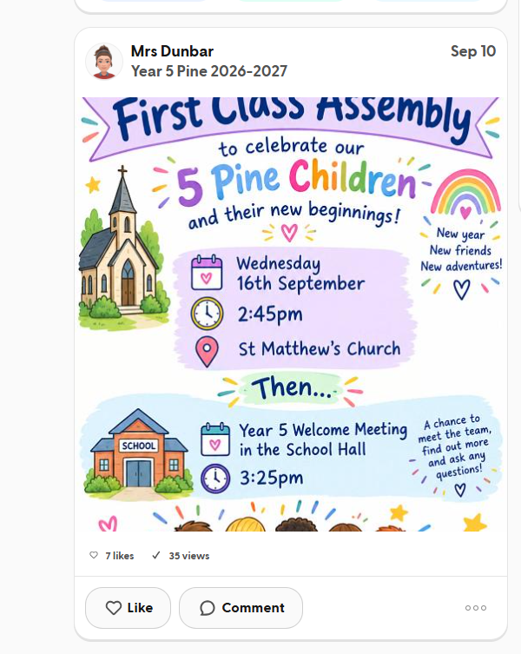
Communication

Slide 8

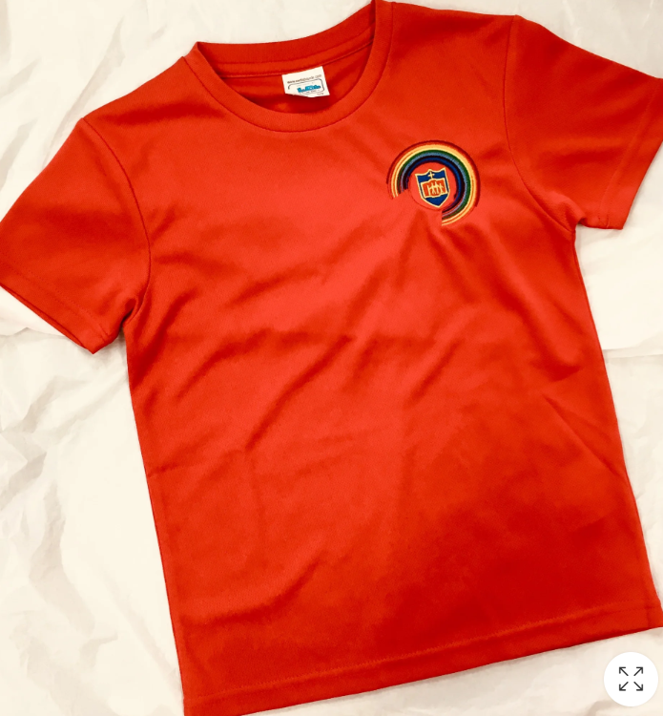
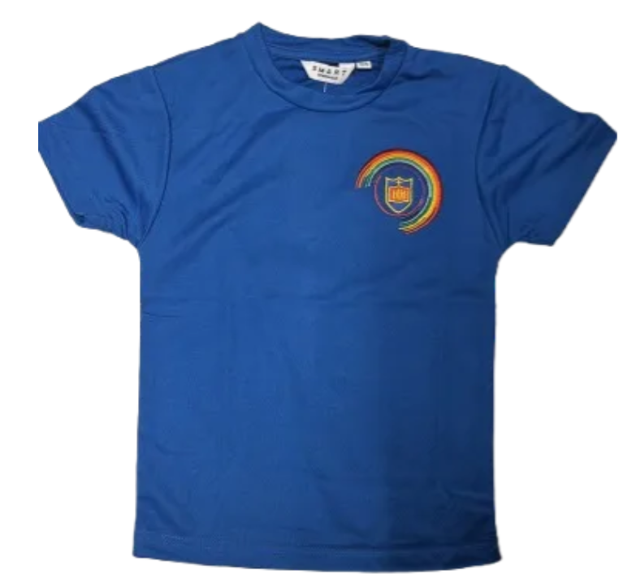
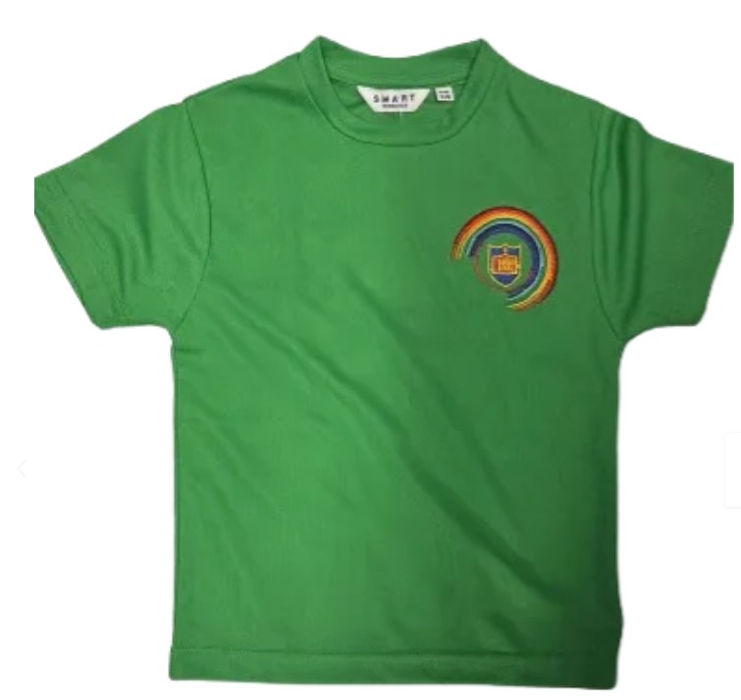
Uniform and PE Kits
Uniform:
White shirt/blouse
Grey jumper or cardigan
Grey trousers, dress, or skirt
School tie
Plain black shoes, No trainers
Long hair tied back ✂️
❌ No jewellery, false nails, or nail varnish
Please note: it is not a reasonable adjustment to not wear uniform, difficulties speak to staff
PE (Monday & Friday for both classes):
House colour shirt with school logo
Blue shorts
Black pumps or trainers
School PE tracksuit can be worn in colder months

Slide 9
Expectations and Standards: The St Matthew’s Way
The St Matthew’s Way means providing consistently high standards for every child, in every classroom, every day.
Children are welcomed warmly and known as individuals.
Adults model calm, respectful and professional behaviour.
Classrooms are organised, purposeful and ready for learning.
Expectations for learning, behaviour and presentation are consistently high.
Lessons are well planned, appropriately challenging and adapted to meet need.
Reading, handwriting, number fluency and oracy remain visible priorities.
Staff actively teach, circulate, question and respond rather than remaining at a desk.
Agreed routines, policies and individual support plans are followed consistently.
Children’s dignity, safety and wellbeing are protected at all times.
Concerns are addressed promptly and support is requested when needed.
Consistency is not about every classroom looking identical. It is about every child receiving the same high standard of care, teaching and support.

Slide 10


Rewards
Dojo Points/Shop
House Teams
Half-Termly Rewards – house team with the most points will be given a treat for example, bowling, movie afternoon, sports afternoon, etc.
Good to be Green
Gold Star Award
Star of the Week

Slide 11

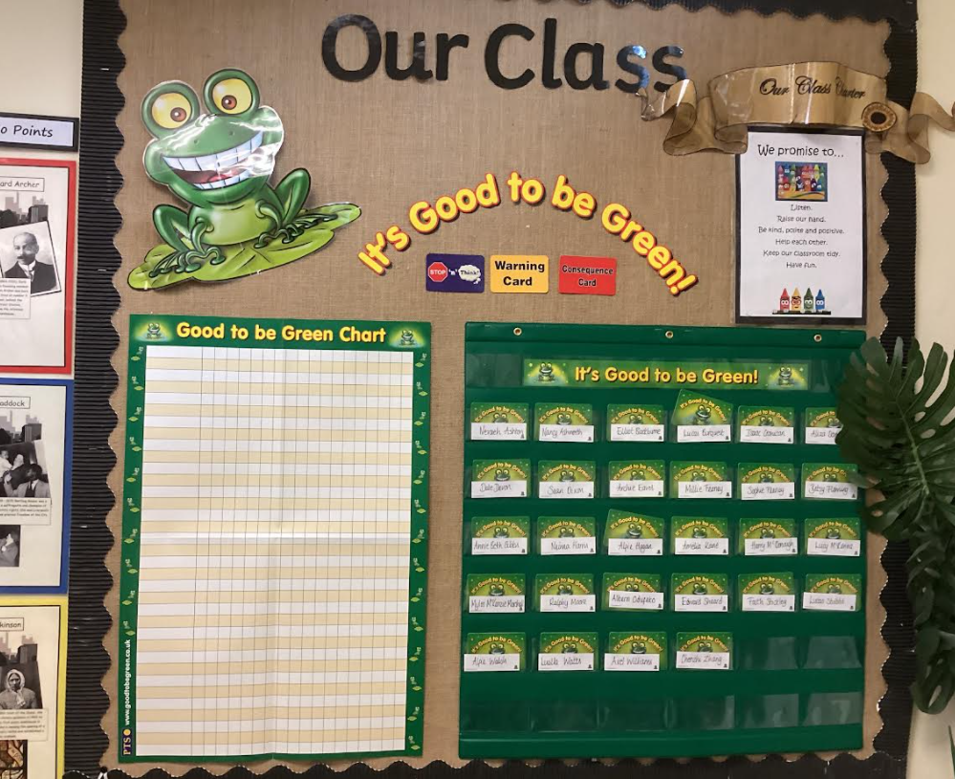



Good to be Green….
Weekly Assembly Rewards!

Slide 12
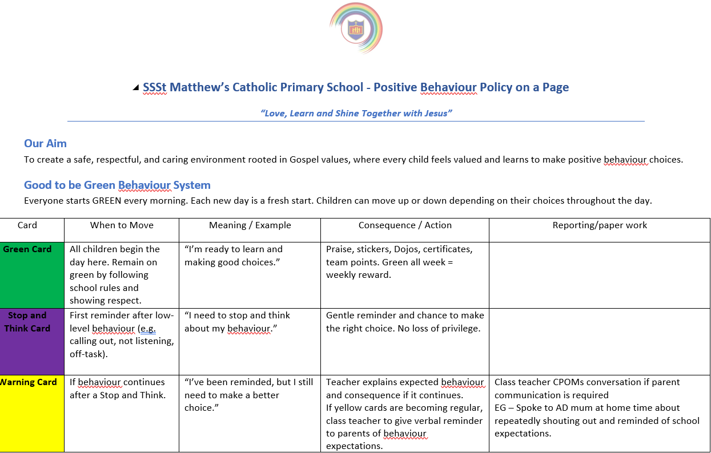

Home/School Agreement / Behaviour and relationship Policy
In the event of children not adhering to the code of conduct, behaviour and relationship the following sanctions will be applied using based on the seriousness of the behaviour.

Slide 13


Homework
Homework is currently being reviewed by staff (based on feedback from parents).
Home reading - books to be signed by an adult. 5 minutes is great! Reading count as school book, magazine, brochure, packaging ANYTHING! Books go out on a Monday to be in school on Thursday and a school member of staff checks and signs the record
Reading plus at home will help support children's progress in school and helps with accurate assessment on the individual.
TT Rockstars/Reading Plus- Every chance you can!

Slide 14

Coming soon
New Mathematics – My Mathematics, Mathematics revision and practice for all, at the children's ability – assesses and adjusts as the children use it.

Slide 15
Medical
Mrs Evans/Mrs Chamberlain can offer advice on medical plans.
Medicines can be administered in school, this must be organised at the school office.
If a child has had First Aid in school you will receive notification. On occasions we may give a courtesy call home
Please let the School Office know if there are any changes to your child’s medical requirements.

Slide 16



Food in School / Allergies Benedict's LAW
Benedict's Law is a set of mandatory school allergy safety requirements taking effect across England starting in September 2026
Lunch times – Please help us to promote healthy lunches.
You can refer to the website for further information.
Please note, we are a nut-free school.
No sweets or cakes in school for birthday treats

Slide 17
Information
Any further information can be found on our school website including: -
Policies
Uniform Details
Contact Information
Curriculum Information

Slide 18
Working in Partnership with Parents – Our promise
Working in partnership with parents and carers is vital
Positive, respectful and timely communication helps us build trust, prevent misunderstandings and secure the best outcomes for every child.
Keep parents informed about learning, progress and any emerging concerns
.Communicate calmly, professionally and respectfully.
Listen carefully and recognise that parents know their children well.
Address concerns early and avoid allowing issues to escalate.
Be clear about what school can do, what parents can do and the agreed next steps.
Record significant conversations and follow up agreed actions
Maintain confidentiality and never discuss children or families inappropriately.
Use agreed communication channels and involve a senior leader when needed.
We may not always agree, but we must always communicate respectfully and remain focused on the child.

Slide 19

Please don’t hesitate to contact us with any issues, we would be more than happy to have a chat.

